Slide 1
Flight Delays
Can they be predicted?
The Coding Dojo
Saurabh Vaze
August 5, 2022

Slide 2
Why should you care?
As an airline capacity planner, this analysis of flight behavior to predict whether a flight delay is likely will return immediate benefits and reduce ineffective future initiatives in On-Time improvement.
Successfully identifying and minimizing delays will improve customer satisfaction+retention, maximize aircraft efficiency, and minimize airport bottlenecks caused by frequent(and predictable) delays
This study can help develop an “ideal” profile of a flight that is predicted to be delayed, and will help your team target their efforts and potential spending more directly to limit the delays within these at-risk flight groups

Slide 3
The Numbers - Overview
Dataset Size: >11,000 individual flights
Inputs:
Airline
AirportFrom (Departure)
AirportTo (Arrival)
Time
Length
DayOfWeek
Output:
Flight Delayed? (Yes/No)

Slide 4
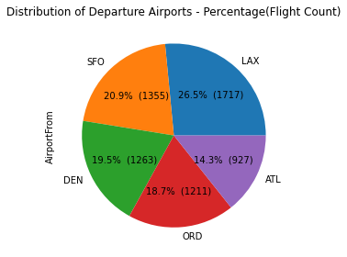
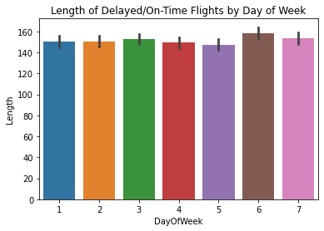
The Numbers - Visualized

Slide 5
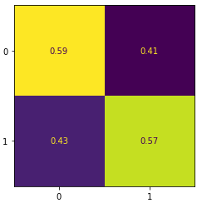
Modeling Towards our Goals
1 = Delay; 0 = On-Time
False Positive: Flight was actually On-Time, but predicted as Delayed
False Negative: Flight was actually Delayed, but predicted as On-Time
Correct prediction was made more often than not, but significant incorrect predictions still continue to exist
False Positive
Actual Value
False Negative
Prediction

Slide 6
What did we learn (and what can we do)?
It is possible to predict whether delays are likely, but will need further work to build a more reliable and consistent prediction system
Next Steps/Improvements:
MORE DATA
More new features (seasonality, passenger volume of airport, weather, etc.), more airports, airlines, more time granularity…
More diverse flight distribution
More numeric features
International+Domestic Flight datasets

